Slide 1
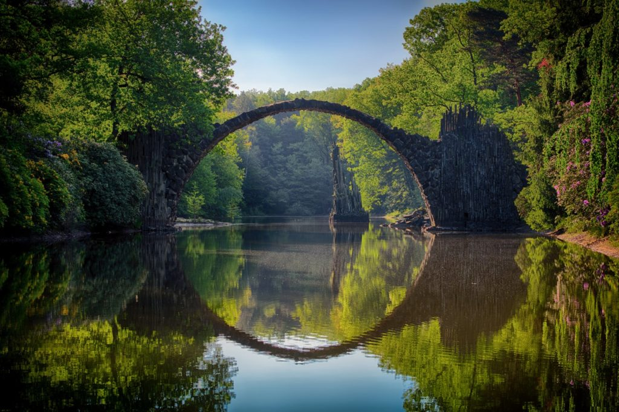
ATLANTIS
BY: SEAFRET

Slide 2
The birds have left their trees The light pours onto me I can feel you lying there all on your own We got here the hard way All those words that we exchange Is it any wonder things get broke?

Slide 3
'Cause in my heart and in my head I'll never take back the things I said So high above, I feel it coming down She said, in my heart and in my head Tell me why this has to end Oh, no, oh, no

Slide 4
I can't save us, my Atlantis, we fall We built this town on shaky ground I can't save us, my Atlantis, oh, no We built it up to pull it down

Slide 5
Now all the birds have fled The hurt just leaves me scared Losing everything I've ever known It's all become too much Maybe I'm not built for love If I knew that I could reach you, I would go

Slide 6
It's in my heart and in my head You can't take back the things you said So high above, I feel it coming down She said, in my heart and in my head Tell me why this has to end Oh, no, oh, no

Slide 7
I can't save us, my Atlantis, we fall We built this town on shaky ground I can't save us, my Atlantis, oh, no We built it up to pull it down

Slide 8
Yeah, we build it up and we build it up Yeah, we build it up to pull it down And we build it up and we build it up And we build it up to pull it down

Slide 9
I can't save us, my Atlantis, we fall We built this town on shaky ground I can't save us, my Atlantis, oh, no We built it up to pull it down

